Slide 1

Scheduling

Slide 2

Syllabus
Scheduling: Types of Scheduling, Scheduling Algorithms: FCFS, SJF, Priority, Round Robin.
Notes:
MIT-WPU

Slide 3
Scheduling
Maximum CPU utilization obtained with multiprogramming
CPU–I/O Burst Cycle – Process execution consists of a cycle of CPU execution and I/O wait.

Slide 4

Alternating Sequence of CPU And I/O Bursts
Operating System Concepts

Slide 5
CPU / Process Scheduler
Selects from among the processes in memory that are ready to execute, and allocates the CPU to one of them.
Scheduling may be preemptive or nonpreemptive
Nonpreemptive – If CPU allocated to a process, it keeps the CPU until it releases it by terminating or switching to waiting state
Preemptive - If CPU allocated to a process, it may be released if high priority process needs the CPU

Slide 6
Scheduler
CPU scheduling decisions may take place when a process:
  1.Switches from running to waiting state
  2.Switches from running to ready state
  3.Switches from waiting to ready state
  4.Terminates
Scheduling under 1 and 4 is nonpreemptive
All other scheduling is preemptive
Notes:
MIT-WPU

Slide 7
Scheduling Algorithms
They deal with the problem of deciding which of the processes in ready queue is to be allocated the CPU
Algo. compared based on following criteria
CPU utilization – keep the CPU as busy as possible
Throughput – # of processes completed or amount of work done per unit time
Turnaround time – time of submission of a process at the time of completion
Waiting time – amount of time a process has been waiting in the ready queue
Response time – amount of time it takes from when a request was submitted until the first response is produced

Slide 8
Optimization Criteria
Max CPU utilization
Max throughput
Min turnaround time
Min waiting time
Min response time
Operating System Concepts

Slide 9
Types of process schedulers / Scheduling categories
Scheduling is broken down into three categories:
1. Long term scheduling:
  Is performed when a new process is created.
  Long-term scheduler (or job scheduler) – selects which processes should be brought into the ready queue.
  Long-term scheduler is invoked very infrequently (seconds, minutes) ⇒ (may be slow)
  The long-term scheduler controls the degree of multiprogramming.

Slide 10
Types of process schedulers / Scheduling categories
  2. Medium term scheduling:
Part of the swapping function
Swapping-in decisions are taken by medium term scheduler
Based on the need to manage the degree of multiprogramming
  3.Short term scheduling:
  Determines which ready process will be assigned the CPU when it next becomes available and actually assign the CPU to this process .
  Short-term scheduler (or CPU scheduler) – selects which process should be executed next and allocates CPU.
  Short-term scheduler is invoked very frequently (milliseconds)⇒ (must be fast).

Slide 11
Types of process schedulers / Scheduling categories
New
Long term
scheduling
Long term
scheduling
Suspended
Ready
Running
Terminated
short term
scheduling
medium term
scheduling

Slide 12
Scheduling Algorithms
FCFS (First Come First Serve)
SJF (Shortest Job First)
Priority scheduling
Round Robin scheduling

Slide 13
FCFS Scheduling: Characteristics
Selection Function: max(w), selects the process which is waiting in the ready queue for maximum time.
Decision Mode : Non_preemptive
Throughput: Not emphasized
Response Time: May be high, especially if there is a large variance in the process execution times.
Overhead: Minimum
Effect on Processes: Penalizes short processes
Starvation: No

Slide 14
Process Burst Time
P1 24
P2 3
P3 3
Suppose that the processes arrive in the order: P1 , P2 , P3

Slide 15
The Gantt Chart for the schedule is:
P₁
P₂
P₃
0
24
27
30

Slide 16
The Gantt Chart for the schedule is:
P₁
P₂
P₃
0
24
27
30
Waiting time for P1 = 0; P2 = 24; P3 = 27
Average waiting time: (0 + 24 + 27)/3 = 17
Turnaround time for P1 = 24; P2 = 27; P3 = 30
Average turnaround time : (24 + 27 + 30)/3 = 27

Slide 17
FCFS Scheduling (Cont.)
Suppose that the processes arrive in the order : P2 , P3 , P1
P₂
P₃
P₁
0
3
6
30

Slide 18
FCFS Scheduling (Cont.)
Suppose that the processes arrive in the order : P2 , P3 , P1
P₂
P₃
P₁
0
3
6
30
Waiting time for P1 = 6; P2 = 0; P3 = 3
Average waiting time: (6 + 0 + 3)/3 = 3
Turnaround time for P1 = 30; P2 = 3; P3 = 6
Average turnaround time : (30 + 3 + 6)/3 = 13

Slide 19
Example-2 of FCFS
Process Arrival Time Burst Time
P1 0.0 7
P2 2.0 4
P3 4.0 1
P4 5.0 4

Slide 20
Example-2 of FCFS
Process Arrival Time Burst Time
P1 0.0 7
P2 2.0 4
P3 4.0 1
P4 5.0 4
P1 P2 P3 P4
0
7
11
12
16
Average waiting time = (0 + 5 + 7 + 7)/4 = 4.75
Average Turnaround Time = (7+9+8+11)/4=8.75

Slide 21
Shortest-Job-First (SJF) Scheduling
Associate with each process the length of its next CPU burst. Use these lengths to schedule the process with the shortest time
Two schemes:
  nonpreemptive – once CPU given to the process it cannot be preempted until completes its CPU burst
  preemptive – if a new process arrives with CPU burst length less than remaining time of current executing process, preempt. This scheme is know as the Shortest-Remaining-Time-First (SRTF)
SJF is optimal – gives minimum average waiting time for a given set of processes

Slide 22
Example of Non-Preemptive SJF
Process Arrival Time Burst Time
P1 0.0 7
P2 2.0 4
P3 4.0 1
P4 5.0 4

Slide 23
Example of Non-Preemptive SJF
Process Arrival Time Burst Time
P1 0.0 7
P2 2.0 4
P3 4.0 1
P4 5.0 4
P₁
P₃
P₂
P₄
0
3
7
8
12
16
Average waiting time = (0 + 6 + 3 + 7)/4 = 4
Average Turnaround Time = (7+10+4+11)/4=8

Slide 24
Shortest Job First Preemptive or Shortest Remaining Time
It is a preemptive version of SJF. In this policy, scheduler always chooses the process that has the shortest expected remaining processing time.
When a new process arrives in the ready queue, it may in fact have a shorter remaining time than the currently running process.
Accordingly, the scheduler may preempt whenever a new process becomes ready.
Scheduler must have an estimate of processing time to perform the selection function.
COMPUTER SCIENCE AND INFORMATION TECHNOLOGY-I

Slide 25
Shortest Job First Preemptive or Shortest Remaining Time: characteristics
Selection Function: minimum total service time required by the process, minus time spent in execution so far.
Decision Mode : Preemptive ( At arrival time)
Throughput: High
Response Time: Provides good response time
Overhead: Can be high
Effect on Processes: Penalizes long processes.
Starvation: Possible
COMPUTER SCIENCE AND INFORMATION TECHNOLOGY-I

Slide 26
Example of Preemptive SJF
Process Arrival Time Burst Time
P₁ 0.0 7
P₂ 2.0 4
P₃ 4.0 1
P₄ 5.0 4
P₁
P₂
P₃
P₂
P₄
P₁
0
2
4
5
7
11
16
COMPUTER SCIENCE AND INFORMATION TECHNOLOGY-I

Slide 27
Example of Preemptive SJF
Process Arrival Time Burst Time
P₁ 0.0 7
P₂ 2.0 4
P₃ 4.0 1
P₄ 5.0 4
P₁
P₂
P₃
P₂
P₄
P₁
0
2
4
5
7
11
16
Average waiting time = (9 + 1 + 0 +2)/4 = 3
Average turnaround time= (16+5+1+6)/4=7
COMPUTER SCIENCE AND INFORMATION TECHNOLOGY-I

Slide 28
Priority Scheduling
A priority number (integer) is associated with each process
The CPU is allocated to the process with the highest priority (smallest integer ≡ highest priority)
  Preemptive
  Nonpreemptive
SJF is a priority scheduling where priority is the predicted next CPU burst time
Problem ≡ Starvation – low priority processes may never execute
Solution ≡ Aging – as time progresses increase the priority of the process

Slide 29
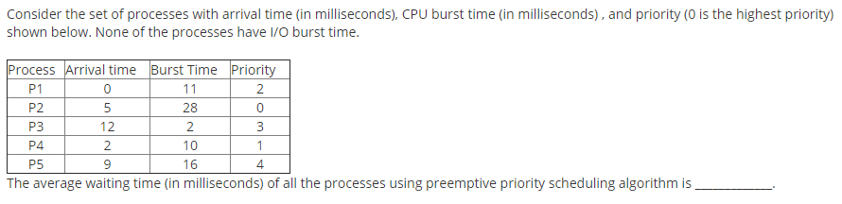
Example
COMPUTER SCIENCE AND INFORMATION TECHNOLOGY-I

Slide 30
Example
Answer =29
COMPUTER SCIENCE AND INFORMATION TECHNOLOGY-I

Slide 31
Round Robin (RR)
Each process gets a small unit of CPU time (time quantum)
After this time has elapsed, the process is preempted and added to the end of the ready queue.
If there are n processes in the ready queue and the time quantum is q, then each process gets 1/n of the CPU time in chunks of at most q time units at once.
No process waits more than (n-1)q time units.

Slide 32
RR: characteristics
Selection Function: constant
Decision Mode : Preemptive ( At time quantum)
Throughput: May be low if time quantum is too small
Response Time: Provides good response time for short processes
Overhead: Minimum
Effect on Processes: Fair treatment
Starvation: No

Slide 33
Example of RR with Time Quantum = 20
Process Burst Time
P1 53
P2 17
P3 68
P4 24

Slide 34
Example of RR with Time Quantum = 20
Process Burst Time
P1 53
P2 17
P3 68
P4 24
P₁
P₂
P₃
P₄
P₁
P₃
P₄
P₁
P₃
P₃
0
20
37
57
77
97
117
121
134
154
162
Average waiting time = (81+ 20 + 94+ 97)/4 = 73
Average turnaround time= (134+37+162+121)/4=113.5
Typically, higher average turnaround than SJF, but better response

Slide 35
Example: Round Robin (By Default preemptive: Time Quantum 2)
Process Arrival Time Burst Time
P₁ 0.0 7
P₂ 2.0 4
P₃ 4.0 1
P₄ 5.0 4
COMPUTER SCIENCE AND INFORMATION TECHNOLOGY-I

Slide 36
Example: Round Robin (By Default preemptive: Time Quantum 2)
Process Arrival Time Burst Time
P₁ 0.0 7
P₂ 2.0 4
P₃ 4.0 1
P₄ 5.0 4
P1
P2
P1
P3
P2
P4
P1
P4
P1
0
2
4
6
7
9
11
13
15
16
COMPUTER SCIENCE AND INFORMATION TECHNOLOGY-I

Slide 37
Example: Round Robin (By Default preemptive: Time Quantum 2)
Process Arrival Time Burst Time
P₁ 0.0 7
P₂ 2.0 4
P₃ 4.0 1
P₄ 5.0 4
P1
P2
P1
P3
P2
P4
P1
P4
P1
0
2
4
6
7
9
11
13
15
16
Average waiting time = (9 + 3 + 2 +6)/4 =5
Average turnaround time =(16+7+3+10)/4=9
COMPUTER SCIENCE AND INFORMATION TECHNOLOGY-I

Slide 38
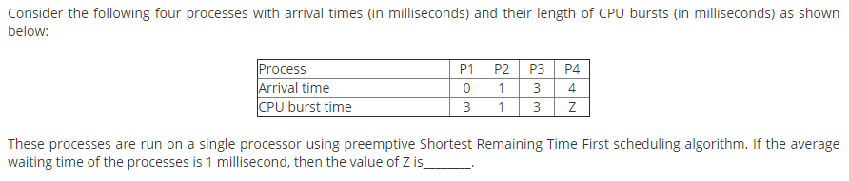
Exercise
COMPUTER SCIENCE AND INFORMATION TECHNOLOGY-I

Slide 39
Exercise
Answer Z=2
COMPUTER SCIENCE AND INFORMATION TECHNOLOGY-I

Slide 40
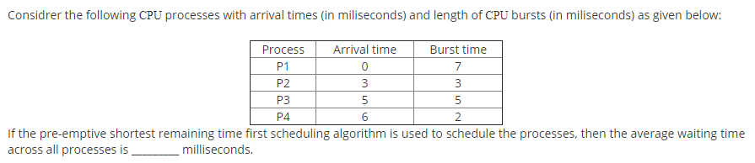
Exercise
COMPUTER SCIENCE AND INFORMATION TECHNOLOGY-I

Slide 41
Exercise
Answer =3
COMPUTER SCIENCE AND INFORMATION TECHNOLOGY-I

Slide 42
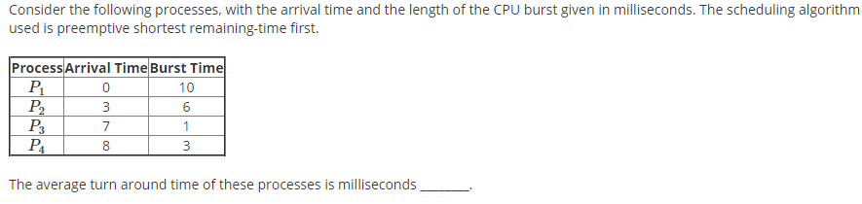
Exercise
COMPUTER SCIENCE AND INFORMATION TECHNOLOGY-I

Slide 43
Exercise
Answer =8.25
COMPUTER SCIENCE AND INFORMATION TECHNOLOGY-I

Slide 44
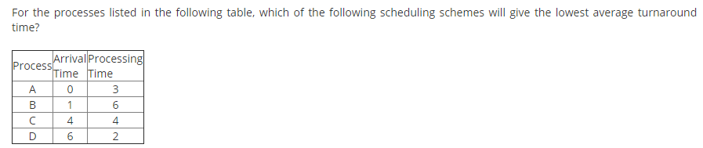
Exercise
COMPUTER SCIENCE AND INFORMATION TECHNOLOGY-I

Slide 45
Exercise
Answer (C) Shortest Remaining Time
COMPUTER SCIENCE AND INFORMATION TECHNOLOGY-I

Slide 46
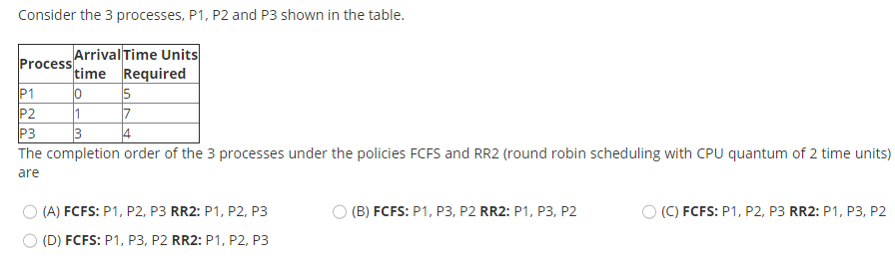
Exercise
COMPUTER SCIENCE AND INFORMATION TECHNOLOGY-I

Slide 47
.
Exercise
Answer (C) FCFS: P1, P2, P3 RR2: P1, P3, P2
In RR, time slot is of 2 units. Processes are assigned in following order p1, p2, p1, p3, p2, p1, p3, p2, p2
This question involves the concept of ready queue. At t=2, p2 starts and p1 is sent to the ready queue and at t=3 p3 arrives so then the job p3 is queued in ready queue after p1.
So at t=4, again p1 is executed then p3 is executed for first time at t=6
COMPUTER SCIENCE AND INFORMATION TECHNOLOGY-I

Slide 48
References
1. William Stallings, Operating System: Internals and Design Principles, Prentice Hall, ISBN-10: 0-13-380591-3, ISBN-13: 978-0-13-380591-8, 8th Edition
2. Abraham Silberschatz, Peter Baer Galvin and Greg Gagne, Operating System Concepts, WILEY,ISBN 978-1-118-06333-0, 9th Edition
21/02/19
Operating system
Notes:
MIT-WPU

